Slide 1
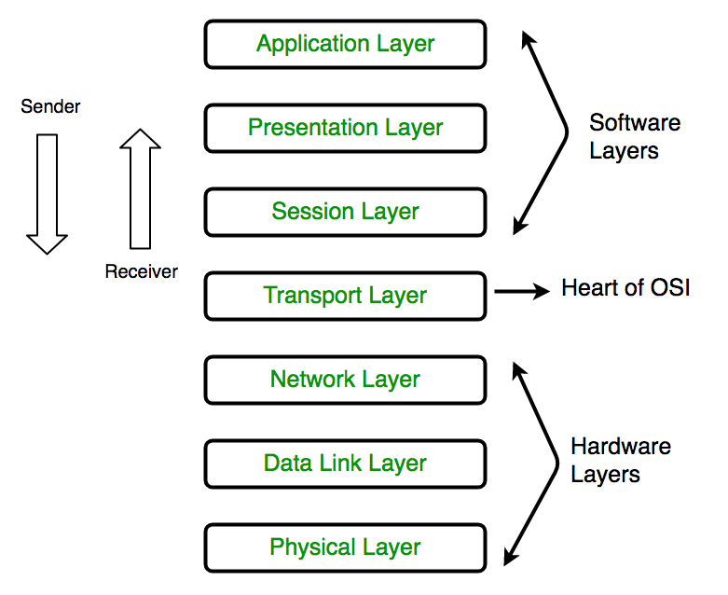
OSI Model : All these 7 layers work collaboratively to transmit the data from one person to another across the globe

Slide 2
What is Amazon VPC? Amazon Virtual Private Cloud (Amazon VPC) enables you to launch AWS resources into a virtual network Amazon VPC is the networking layer for Amazon EC2

